Slide 1

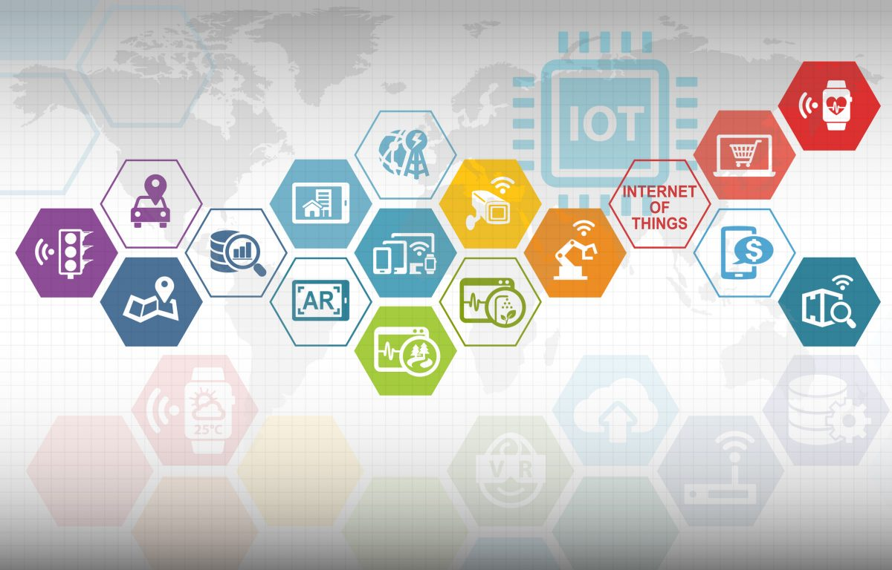
Kick-Start to Your Imagination with
Internet of Things
Speakers: Bhavik Prajapati
Ankit Rana
Tanuka RoyChowdhury

Slide 2
Outlines
What is Internet of Things ?
History
Why do we need IoT ?
Benefits
IoT Architecture
Sensors & Peripherals
Protocols and Technologies
Cloud Platforms
Applications
Practical Demonstration
Questions

Slide 3
What is Internet of Things?
As the name suggest Inter Connectivity of various things or devices using various network and application layer protocols
Definition:
The Internet of Things (IoT) is the network of physical objects-devices, vehicles, buildings and other items embedded with electronics, software, sensors, and network connectivity-that enables these objects to collect and exchange data.
A thing, in the Internet of Things, can be a person with a heart monitor implant, a farm animal with a biochip transponder, an automobile that has built-in sensors to alert the driver when tire pressure is low - or any other natural or man-made object that can be assigned an IP address and provided with the ability to transfer data over a network.

Slide 4
History
1970s
Actual idea of internet of things emerged
It was called Embedded Internet or Pervasive Computing
1999
2010
Google starts developing Self Driving Car
2011
2013
First International Conference for IoT was held
Chinese government announced it would make Internet of things their priority in their next five year plan
Gartner, a market research company that invented “hype cycle for emerging technologies” included Internet of things
1990
Internet of Things had evolved into to a system using multiple technologies, ranging from the Internet to wireless communication and from micro-electromechanical systems (MEMS) to embedded systems
IDC published a report stating that the Internet of Things would be a $8.9 trillion market in 2020
2008
Kevin Ashton coined the term Internet of things for his presentation
He wanted to attract his senior’s attention towards RFID
First connected device- a toaster

Slide 5

History
The term Internet of Things is 16 years old. But the actual idea of connected devices had been around longer, at least since the 70s. Back then, the idea was often called “embedded internet” or “pervasive computing”.
But the actual term “Internet of Things” was coined by Kevin Ashton in 1999 during his work at Procter&Gamble. Ashton who was working in supply chain optimization, wanted to attract senior management’s attention to a new exciting technology called RFID. Because the internet was the hottest new trend in 1999 and because it somehow made sense, he called his presentation “Internet of Things”.
Even though Kevin grabbed the interest of some P&G executives, the term Internet of Things did not get widespread attention for the next 10 years.
Kevin Ashton, inventor of the Internet of Things
Sources: https://iot-analytics.com/internet-of-things-definition/

Slide 6
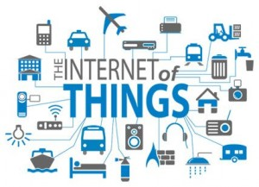
Why?
Why do we need IoT ?
To control stuffs around us
To bring automation
To save money and power consumption
To make our daily life faster and easier
To monitor anything from anywhere
Image from https://www.thedrum.com/opinion/2017/01/05/the-internet-things-presents-new-challenges-marketers

Slide 7
A full fledged solution to our problem
Avail Real Time Data
Cost Management
Identify Problems
Stay Connected to Remote Locations
Reduce Human Intervention
Minimize Resources

Slide 8
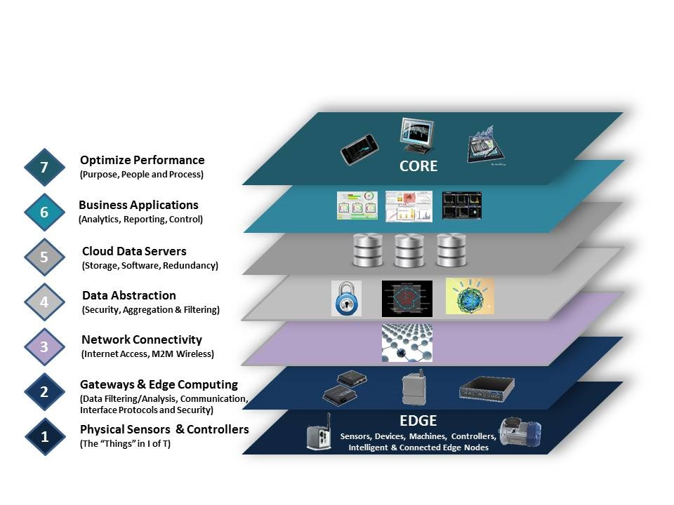
How?
Image from iotaudit.com

Slide 9
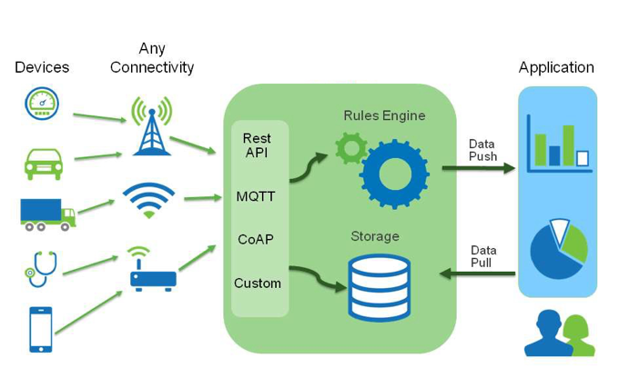
IoT Architecture
Image from https://itviconsultants.com/iot-data-analysis-may-require-hybrid-approach/

Slide 10
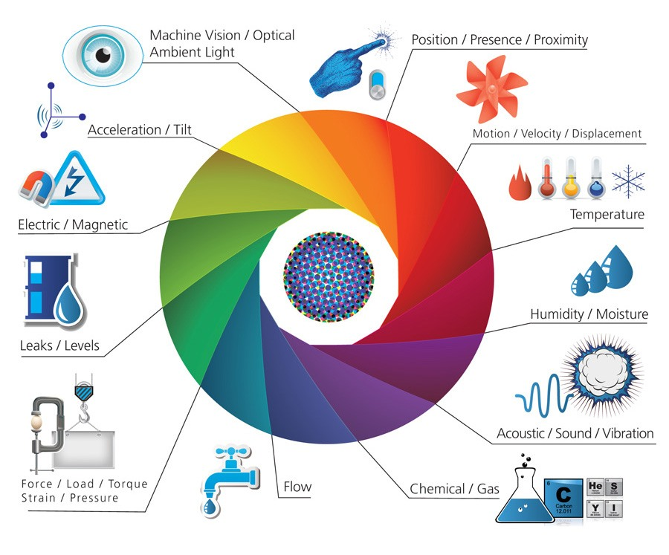
Sensors
A Device which detects or measures a physical property and records, indicates, or otherwise responds to it.
It measures value
Sends data
Low power
Image from Postscapes

Slide 11




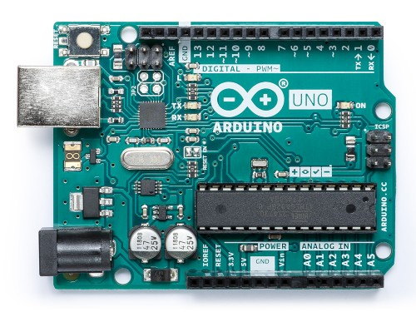
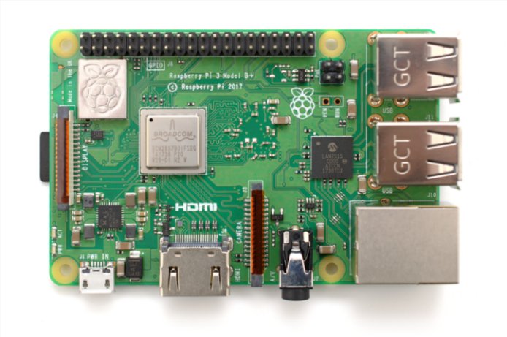
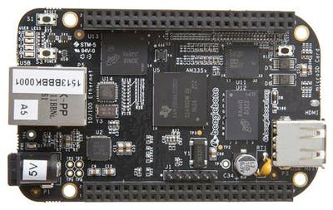
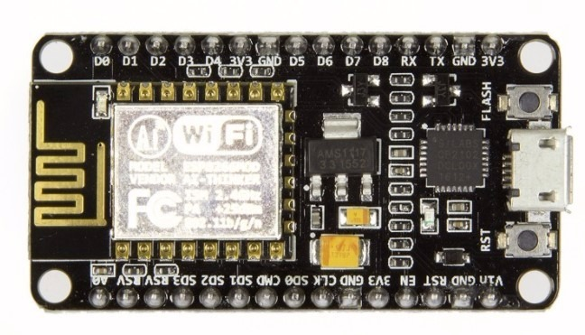
Local Processing and Storage
Get Data from the sensors
Process and store data locally
Send data to the server for further computing

Slide 12
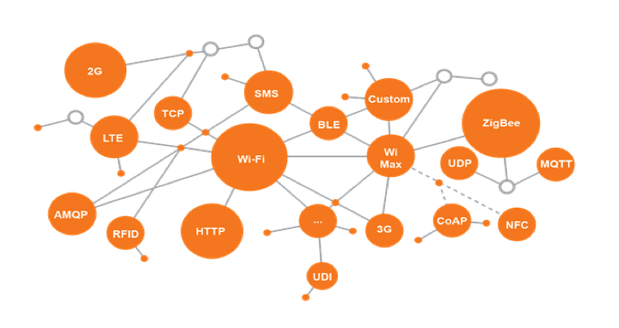
Protocols and Technologies
Images from https://www.iotone.com/

Slide 13

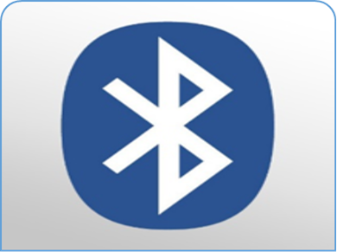





Communication Technologies
Wi-Fi
BLE
LoRa-Wan
Sigfox
IEEE802.11n
Approximately 50m
1-54Mb/s
Bluetooth 4.2
50-150m
1 Mb/s
2-5km
18 b/s - 37.5 kb/s
3-10km
10-1000bps
Zig bee
Z-wave
LTE
Zig Bee 3.0 based on IEEE802.15.4
10-100m
250 kb/s
Z-Wave Alliance ZAD12837 / ITU
30m
9.6/40/100kbit/s
Long range
3-10Mbps

Slide 14
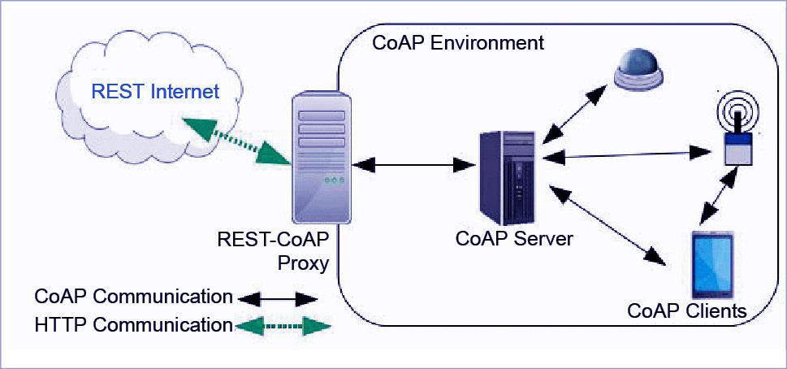
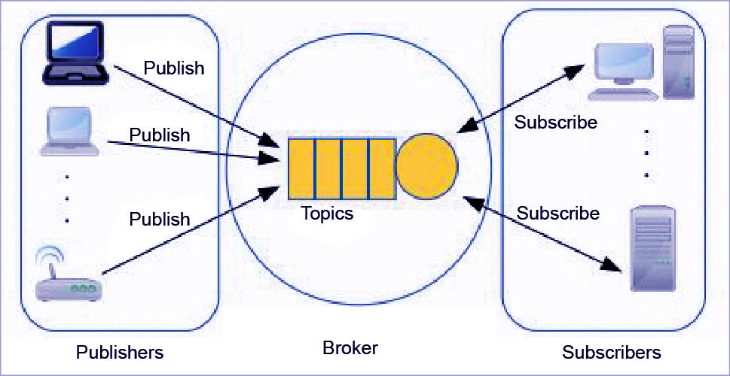
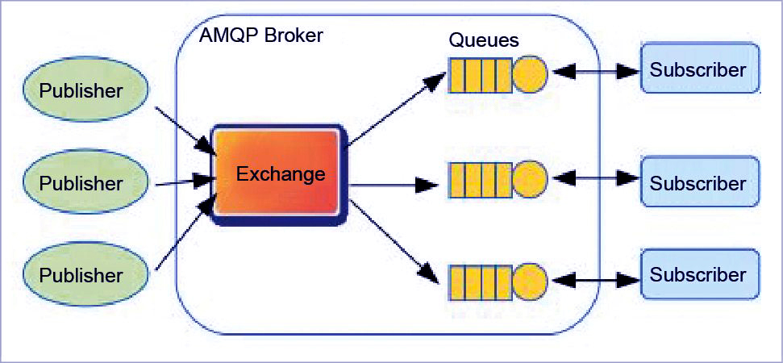
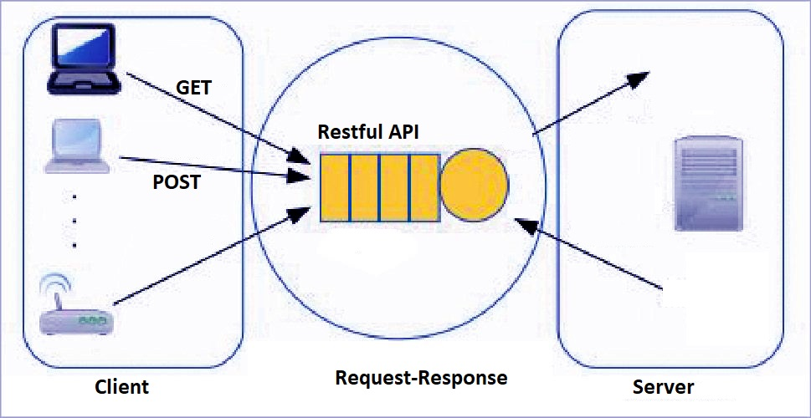
Data Protocols
CoAP
MQTT
MQTT
Http
AMQP
HTTP
Images from https://electronicsforu.com/technology-trends/popular-iot-protocols

Slide 15
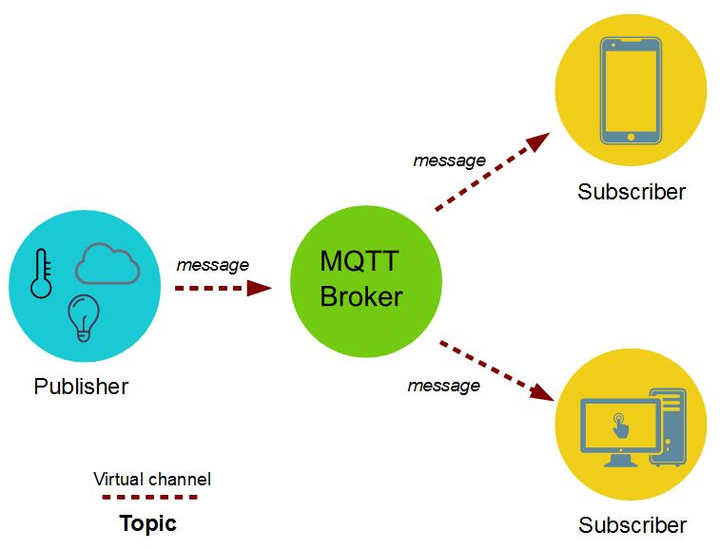
MQTT
MQTT(Message Queue Telemetry Transport) is a Client Server publish/subscribe messaging transport protocol. This protocol is widely used in the field of IoT for communication between Machine to Machine because of its following features ,
Light weight,
Open, and
Designed so as to be easy to implement.
Image from Skyfi Labs

Slide 16



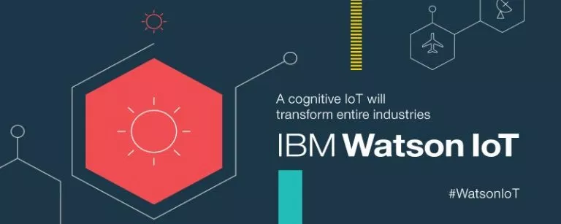
Cloud Platforms
Stores large amount of data
Data Processing
Analytics (Dashboard, Visualization and Real Time Streaming)
Device Management, Secure gateway for devices, Authentication and encryption, Device shadow
Easy Device Registry, Rich Integration with SAP, Salesforce, Oracle, WebSphere, etc. Dashboards and visualization, Real-Time streaming
Provides huge storage, Cuts cost for server maintenance, Business through a fully protected, intelligent, and responsive IoT data, Efficient and scalable, Analyse big data
Real-Time data exchange, Secure Communication, Cognitive systems, Recently added data sensor and weather data service

Slide 17








Open-Source Hardware & Software
Images from each given software

Slide 18
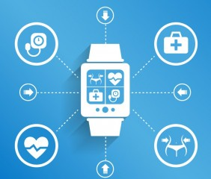
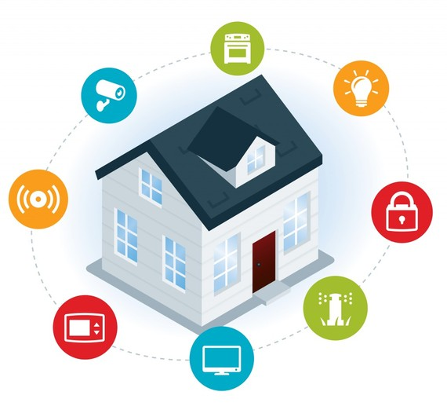
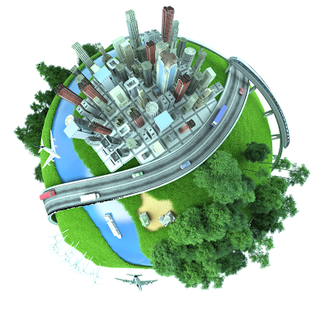
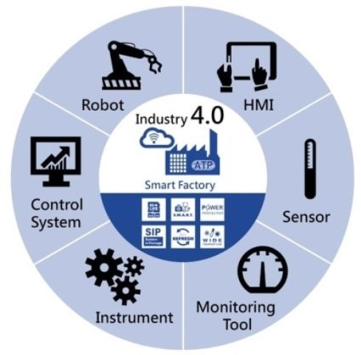
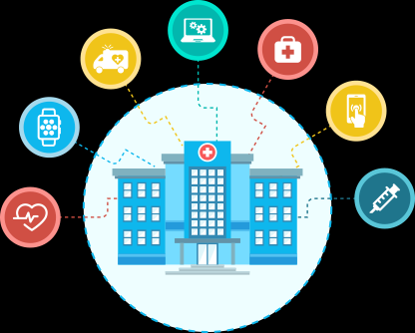
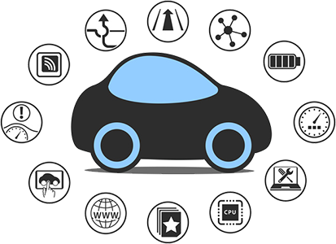
Application
Wearable
Building & Home Automation
Smart Cities
Smart Manufacturing
Entertainment
Fitness
Smart Watch
Location and Tracking
Light and Temperature control
Energy Optimization
Predictive Maintenance
Connected Appliances
Smart Street Lights
Pipeline Leak Detection
Traffic Control
Surveillance Cameras
Centralized and Integrated Control
Flow Optimization
Real Time Inventory
Asset Tracking
Employee Safety
Predictive Maintenance
Firmware Updates
Health Care
Automotive
Remote Monitoring
Ambulance Telemetry
Drugs Tracking
Hospital Asset Tracking
Access Control
Predictive Maintenance
Infotainment
Wire Replacement
Telemetry
Predictive Maintenance
C2C
C2I

Slide 19
Practical Demonstration

Slide 20
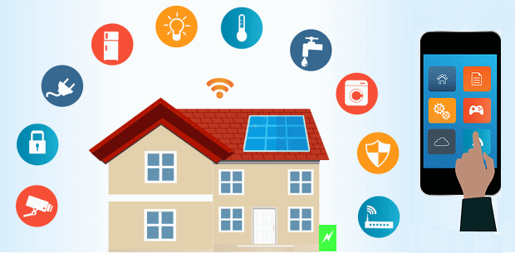
A Simple Touch can make Life Easier!!
Images from https://www.energymatters.com.au/energy-efficiency/smart-home-automation/

Slide 21
What do you need ?
Microcontroller
or
Microprocessor
Relay Module
Webpage
or
Mobile App

Slide 22
Block Diagram
Power Supply
Mobile App
or
Webpage
Data
ESP32
Appliance
Trigger
Relay
Data

Slide 23
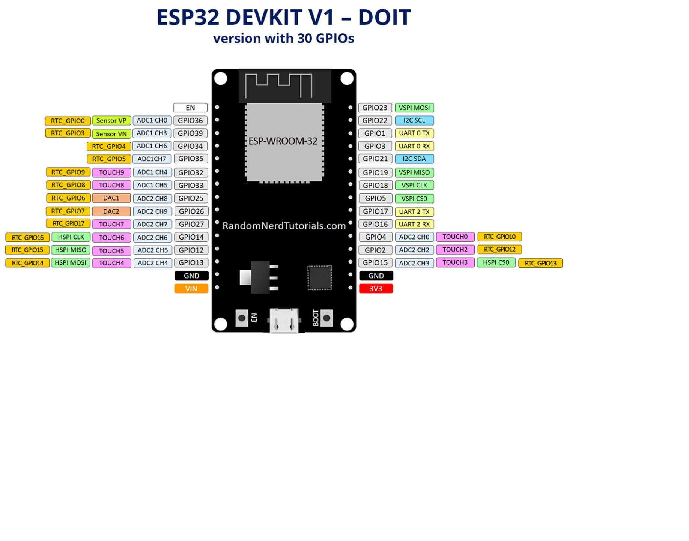
ESP32
Low Cost, low power SoC microcontroller
Integrated Wi-Fi and Bluetooth
Memory : 520 KiB SRAM
Power : 3.3V
Arduino IDE compatible
https://www.espressif.com/sites/default/files/documentation/esp32_datasheet_en.pdf

Slide 24
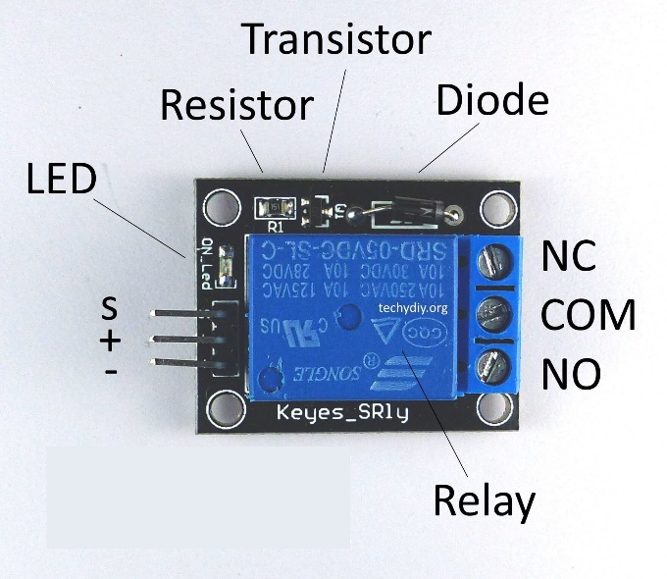
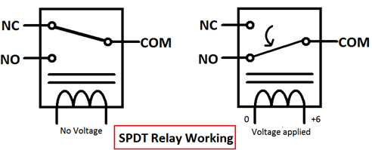
Relay
Relay is a switch which controls (open & close) circuits electromechanically. The main operation of this device is to make or break contact with the help of a signal without any human involvement in order to switch it ON or OFF.
https://circuitdigest.com/article/relay-working-types-operation-applications

Slide 25
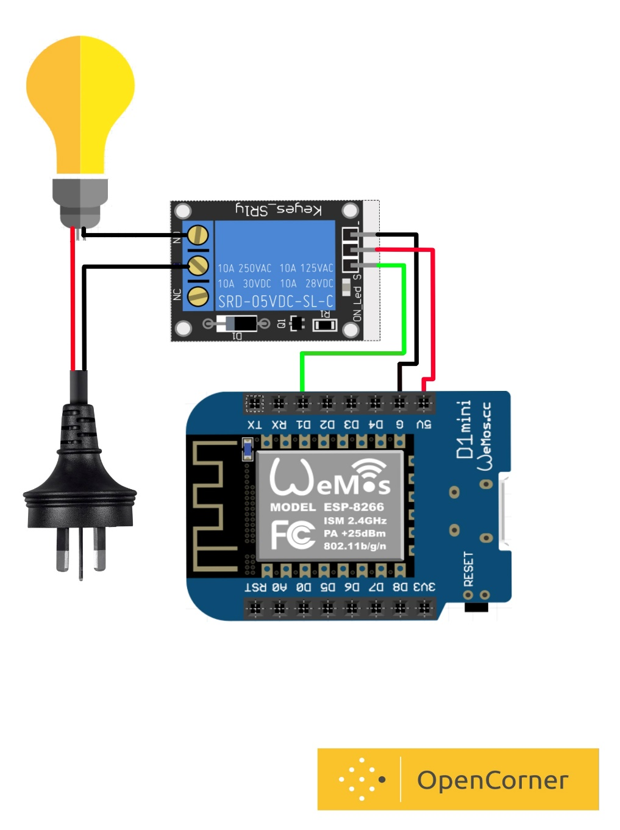

Circuit Diagram

Slide 26
Configure ESP32 in Arduino IDE
Copy https://dl.espressif.com/dl/package_esp32_index.json
Open Arduino IDE -> Go to file -> Preferences -> Paste above link
Go to Tools -> Board -> Boards Manager
Search ESP32 and INSTALL

Slide 27
Do as Directed

Slide 28
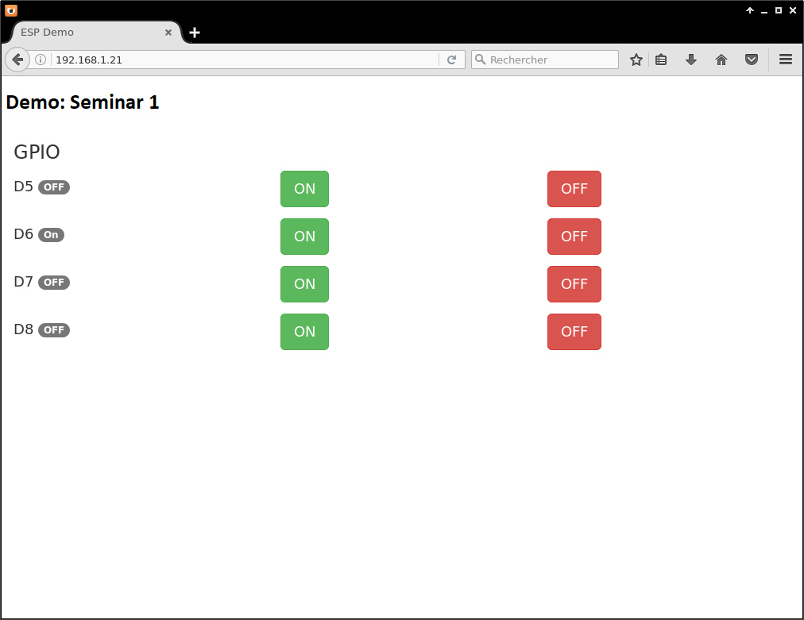
UI for Webpage

Slide 29
?

Slide 30
Contact us
OpenCorner.io
+91 99786 59443
Bhavesh Valand (Digital Head)
+91 85113 91256
Speakers:
Bhavik Prajapati (IoT Developer )
+91 76984 47543
Ankit Rana (IoT Developer)
+91 79845 75610
Tanuka Roychowdhury (IoT Developer)
+91 99250 63810

Slide 31


THANK YOU

